Slide 1

Course: Electronic Engineering UEC001
Topic: K-Map (Karnaugh Map)
Presentation by
Ajay Kakkar
ajay.kakkar@thapar.edu
9781506922
Assistant Professor
Department of Electronics and Communication Engineering,

Slide 2
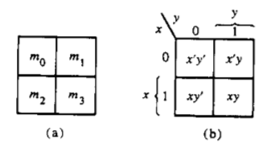
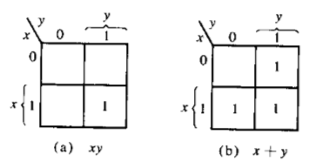
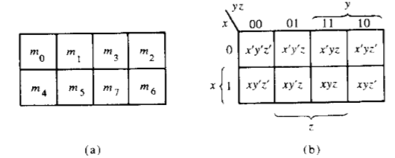


Map
2 Variable Map
3 Variable Map
Reference Book: M. M. Mano and M.D. Ciletti, Digital Design, Pearson, Prentice Hall, 2013.

Slide 3

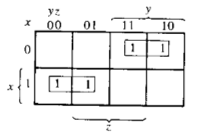


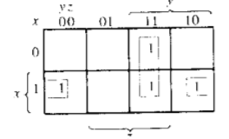

Reference Book: M. M. Mano and M.D. Ciletti, Digital Design, Pearson, Prentice Hall, 2013.

Slide 4

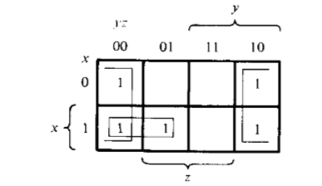

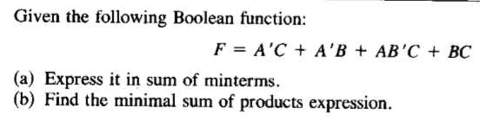
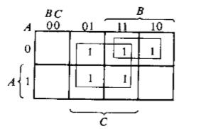


Minterms
Reference Book: M. M. Mano and M.D. Ciletti, Digital Design, Pearson, Prentice Hall, 2013.

Slide 5
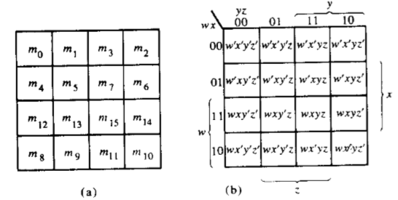

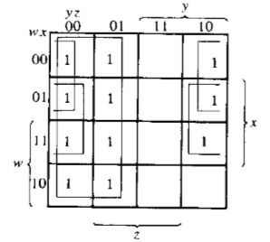

4Variable Map
Reference Book: M. M. Mano and M.D. Ciletti, Digital Design, Pearson, Prentice Hall, 2013.

Slide 6

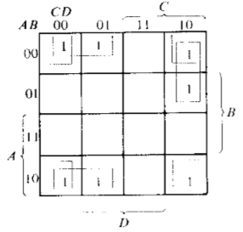

Reference Book: M. M. Mano and M.D. Ciletti, Digital Design, Pearson, Prentice Hall, 2013.

Slide 7
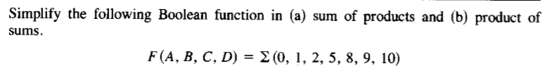
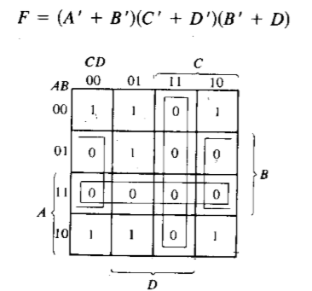


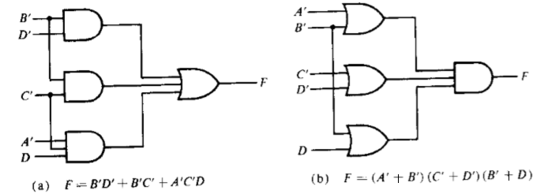


























Reference Book: M. M. Mano and M.D. Ciletti, Digital Design, Pearson, Prentice Hall, 2013.

Slide 8
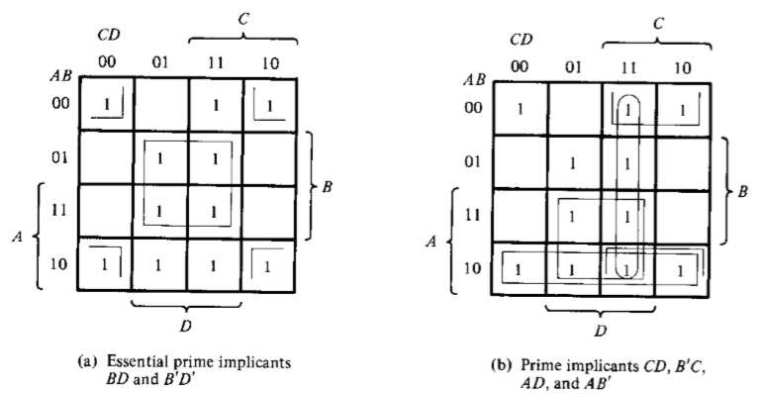
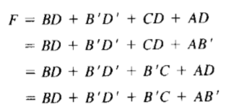
Prime Implicants are the largest pair 2, 4,8, 16.
Reference Book: M. M. Mano and M.D. Ciletti, Digital Design, Pearson, Prentice Hall, 2013.

Slide 9
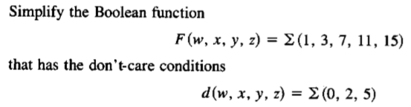
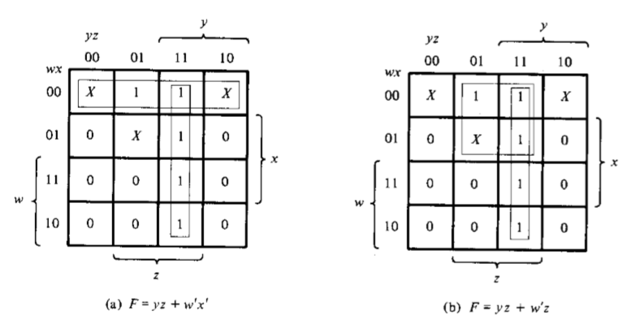






Reference Book: M. M. Mano and M.D. Ciletti, Digital Design, Pearson, Prentice Hall, 2013.

Slide 10



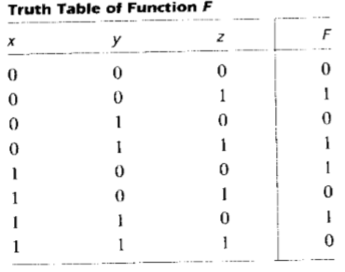












Reference Book: M. M. Mano and M.D. Ciletti, Digital Design, Pearson, Prentice Hall, 2013.

Slide 11
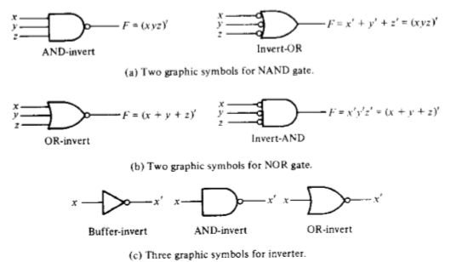
NAND
NOR
Implementation
Reference Book: M. M. Mano and M.D. Ciletti, Digital Design, Pearson, Prentice Hall, 2013.

Slide 12

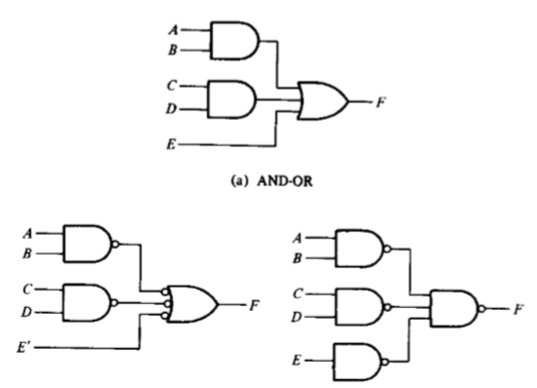

NAND Implementation
Reference Book: M. M. Mano and M.D. Ciletti, Digital Design, Pearson, Prentice Hall, 2013.

Slide 13

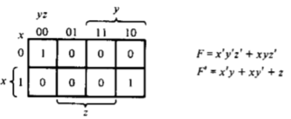
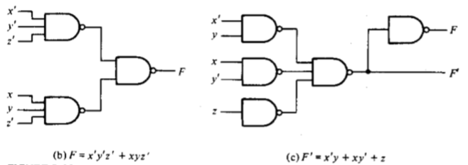
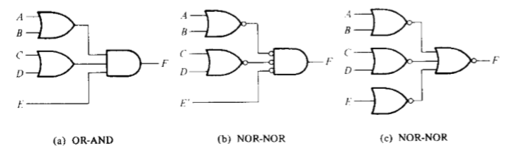

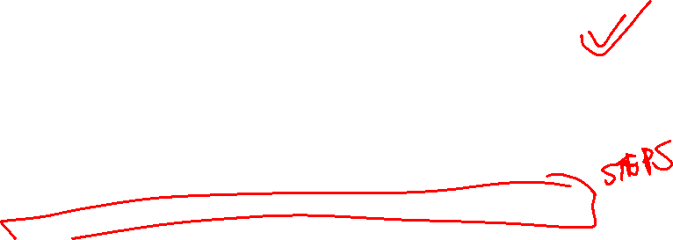
Reference Book: M. M. Mano and M.D. Ciletti, Digital Design, Pearson, Prentice Hall, 2013.

Slide 14

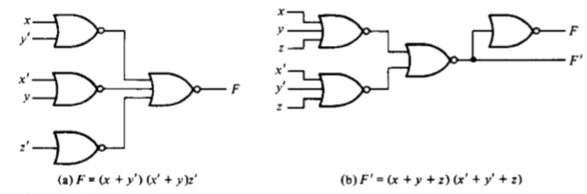



Reference Book: M. M. Mano and M.D. Ciletti, Digital Design, Pearson, Prentice Hall, 2013.

